Slide 1
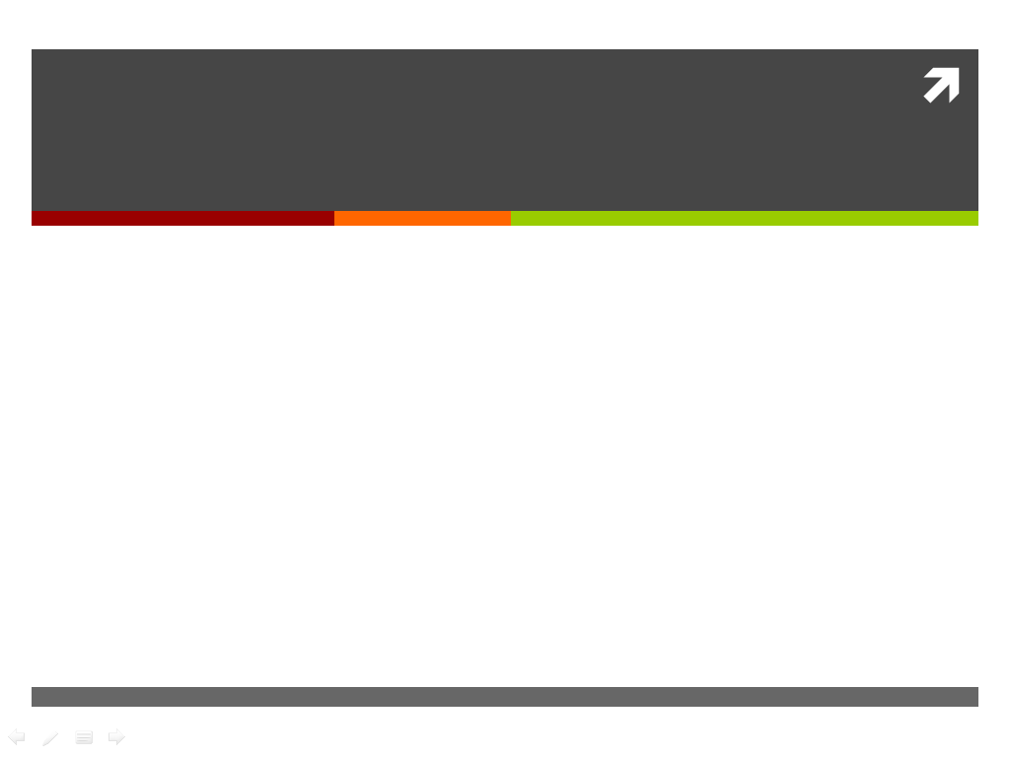

myStatus
Jake Bailey, Emily Chien, Chuong Dao, Rosemary Le

Slide 2
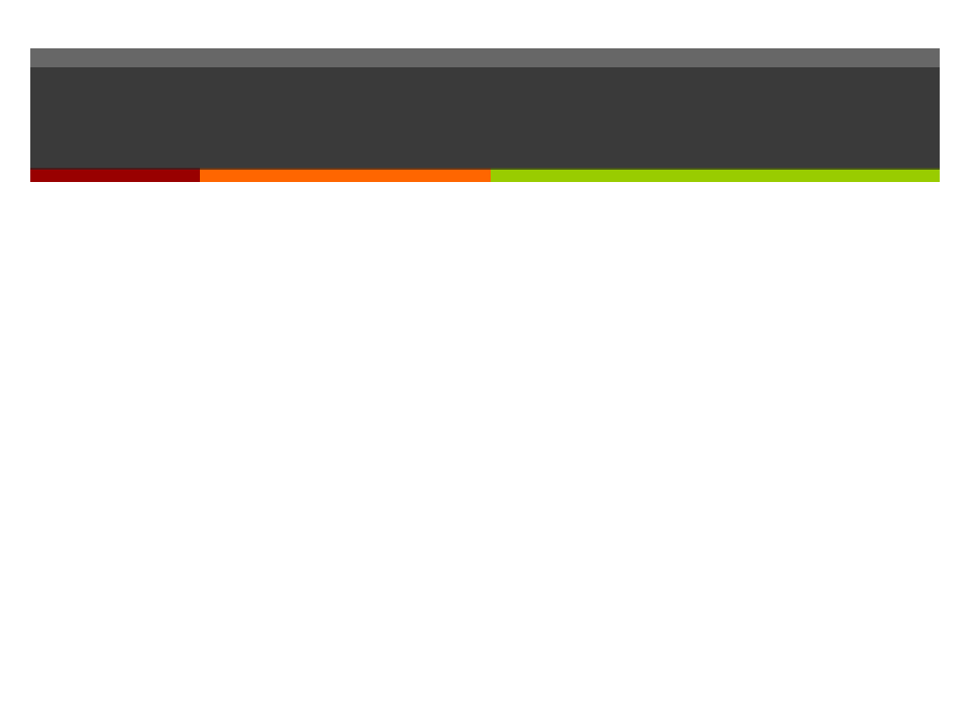
myStatus
Mobile app for self-management of chronic health conditions and self-reporting of status
Collect patient status information using surveys
Submit collected data to care provider
Troubleshoot using branching survey logic
Show response history; progress over time
Remind patients of medications
Provide quick-dial buttons for important contacts
Built with a focus on depression, but generic enough to be used for other conditions

Slide 3
Architecture
myStatus
(based on ODK Collect)
Server
Patient
Data Collection
Survey Responses
Notification Service
Clinician Web Interface
Surveys
Primary Care Provider
Data Visualization Tools
Form Builder

Slide 4
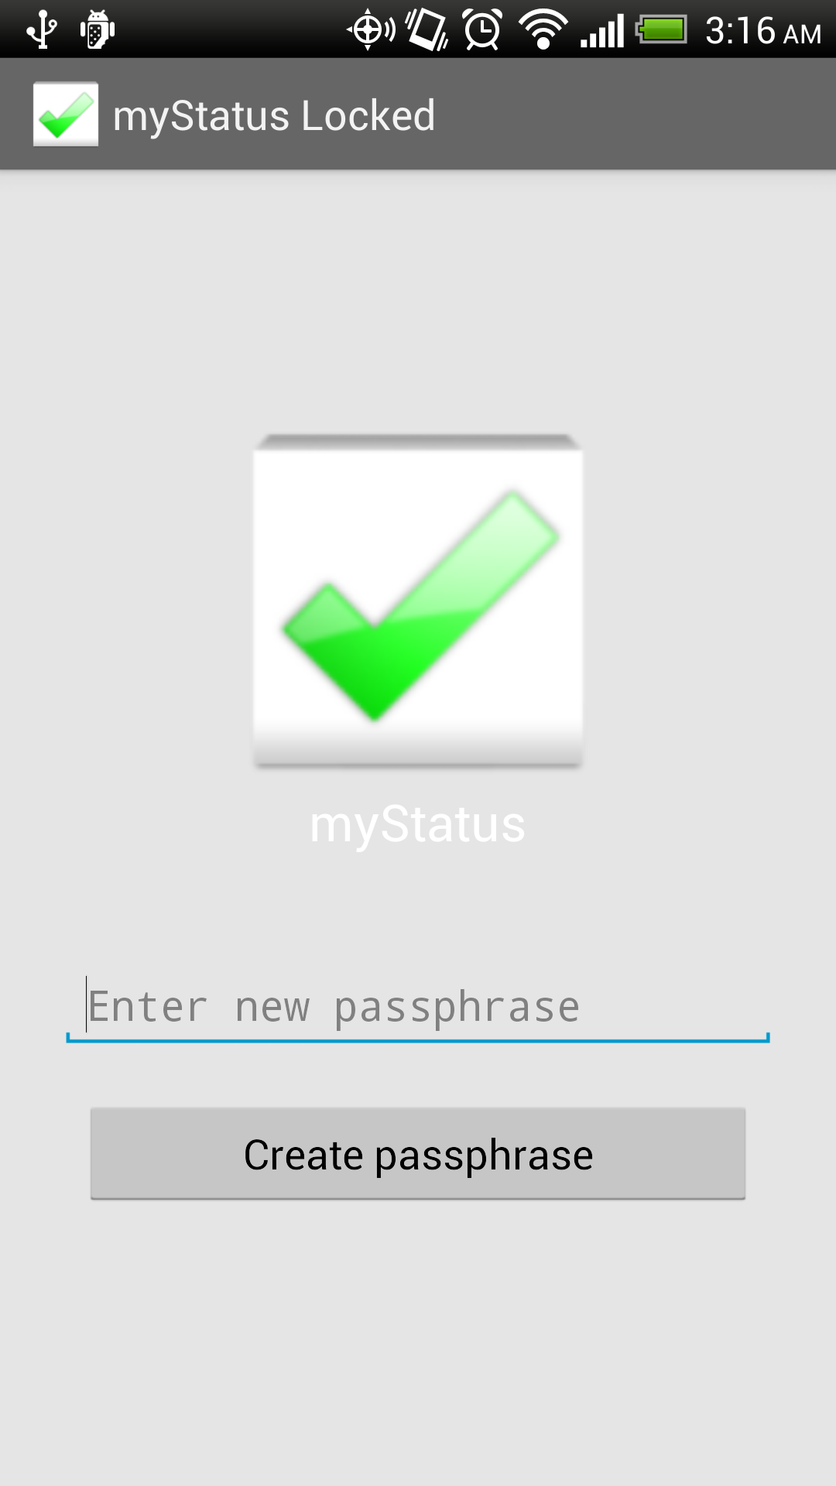
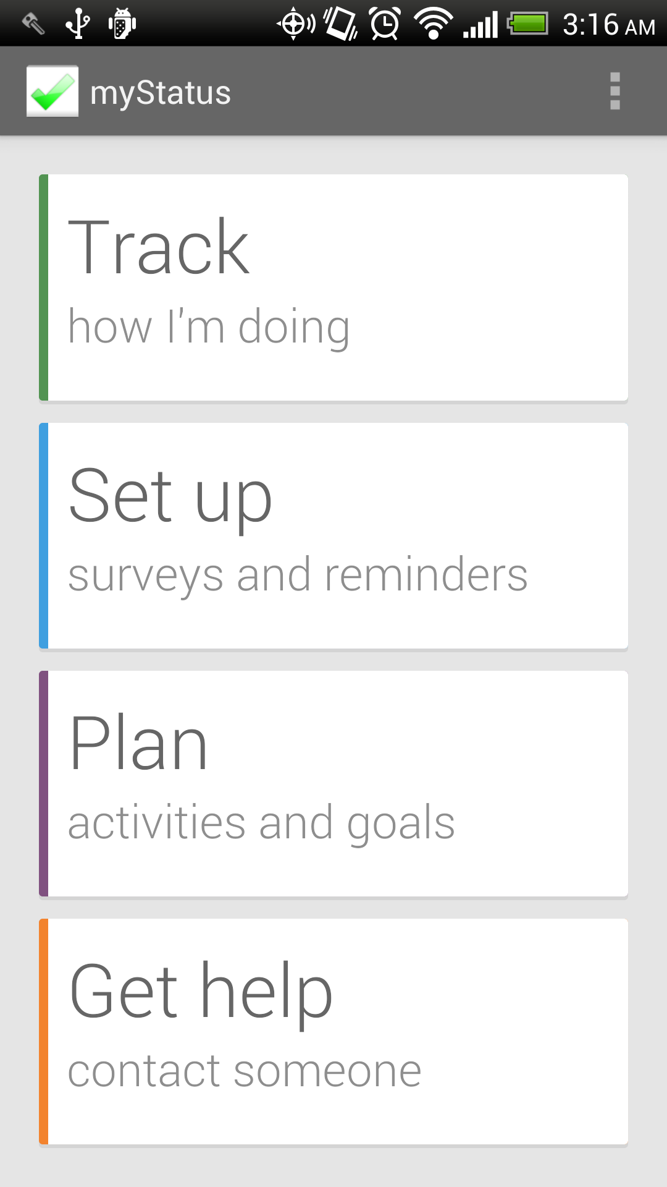
Screenshots

Slide 5
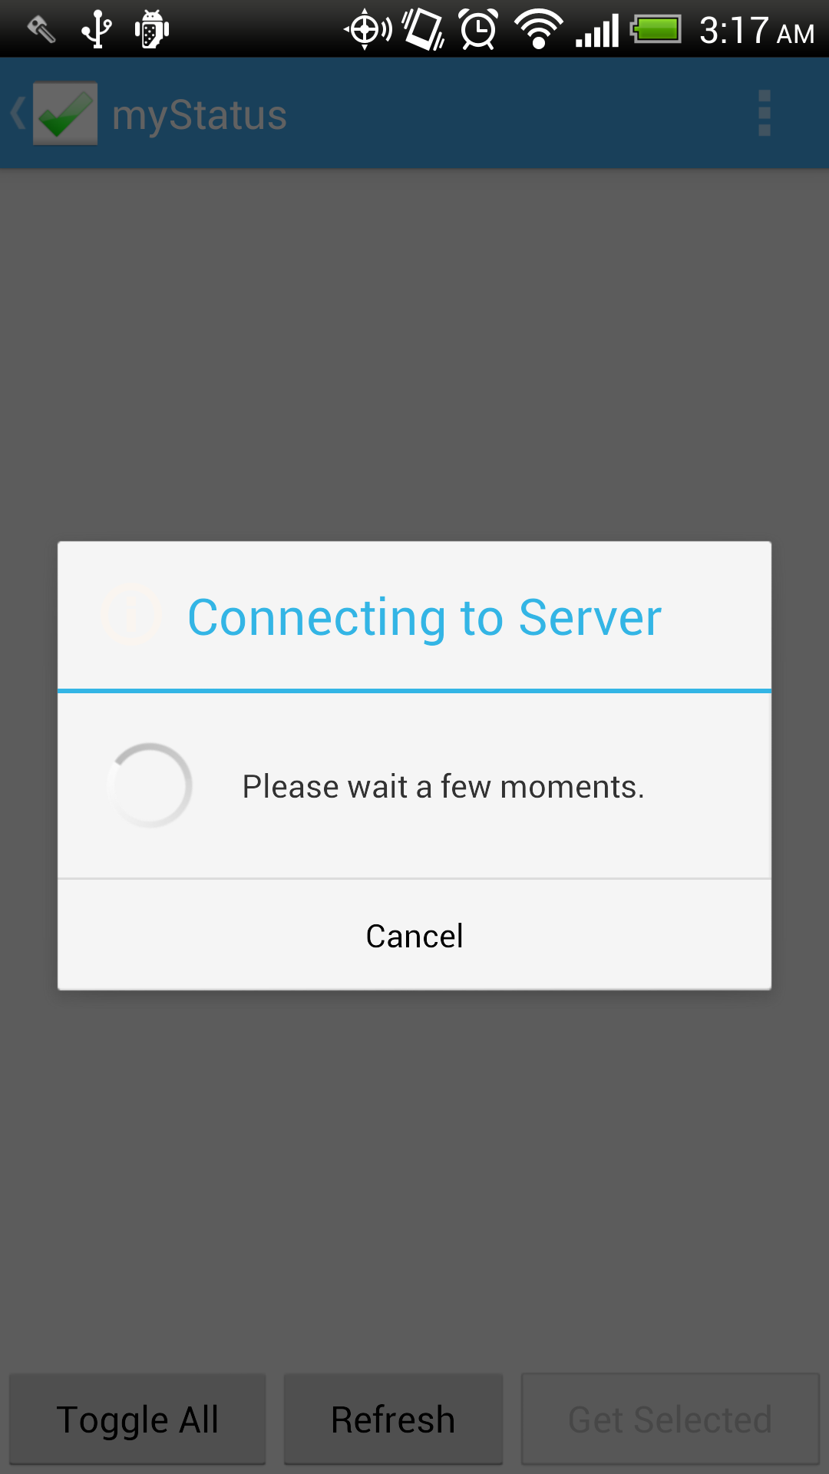
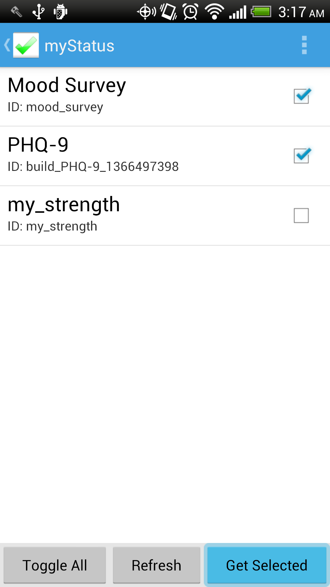
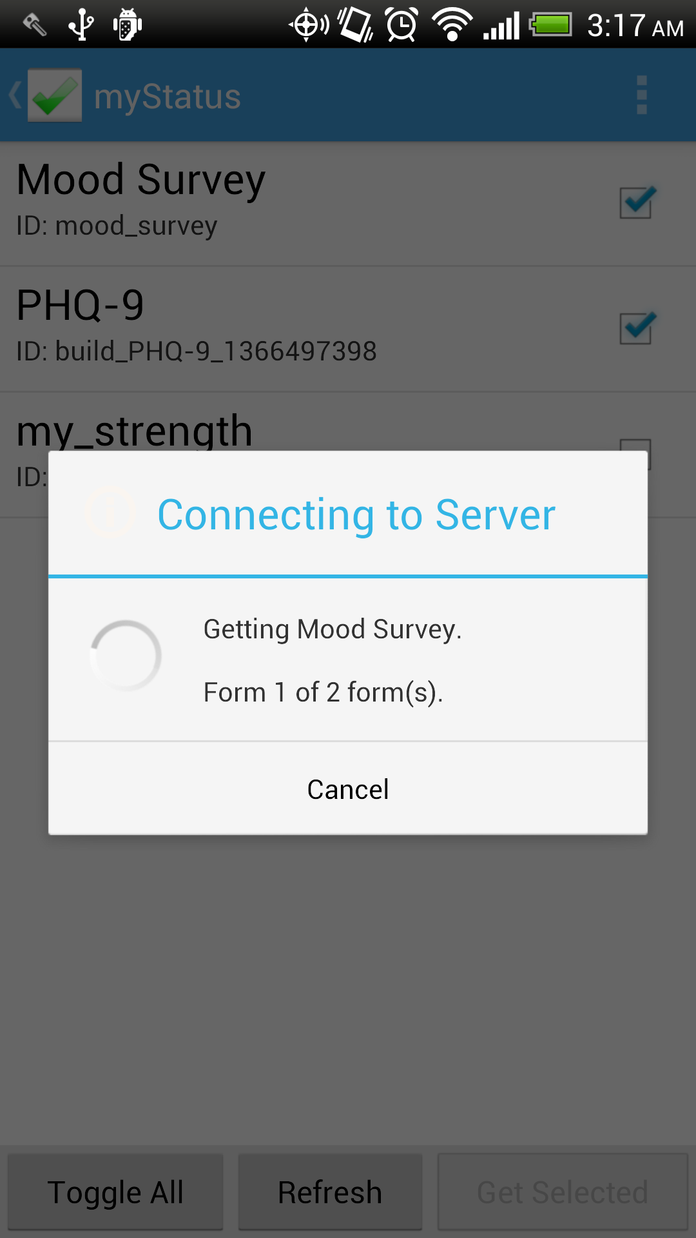
Screenshots

Slide 6
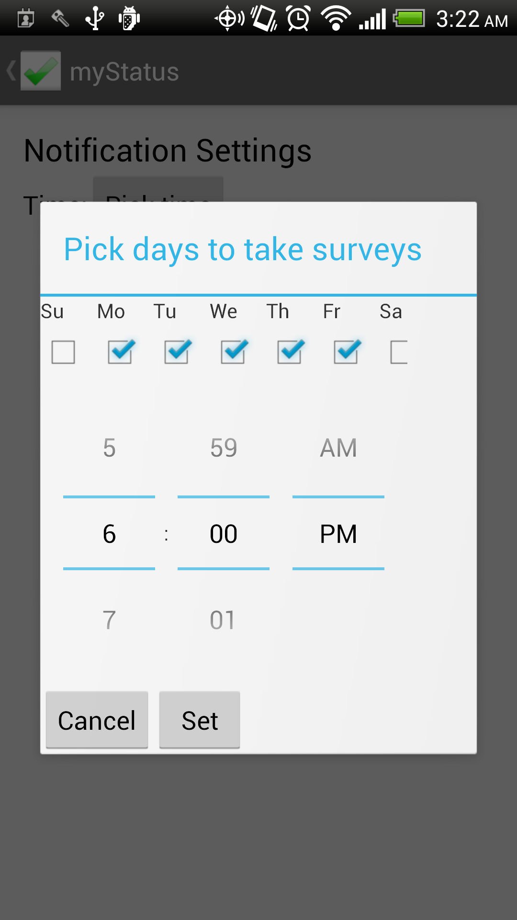
Screenshots

Slide 7
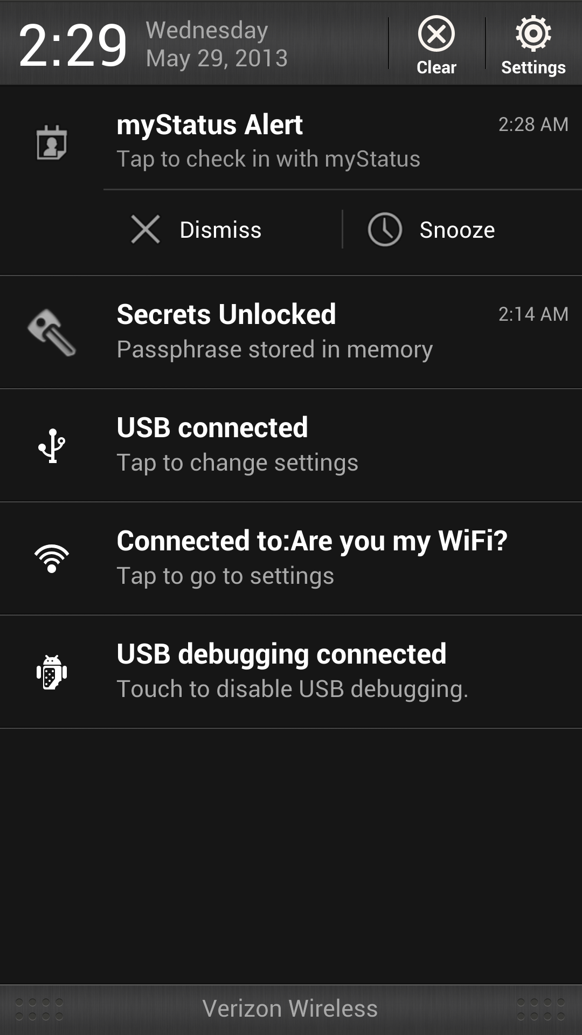
Screenshots

Slide 8
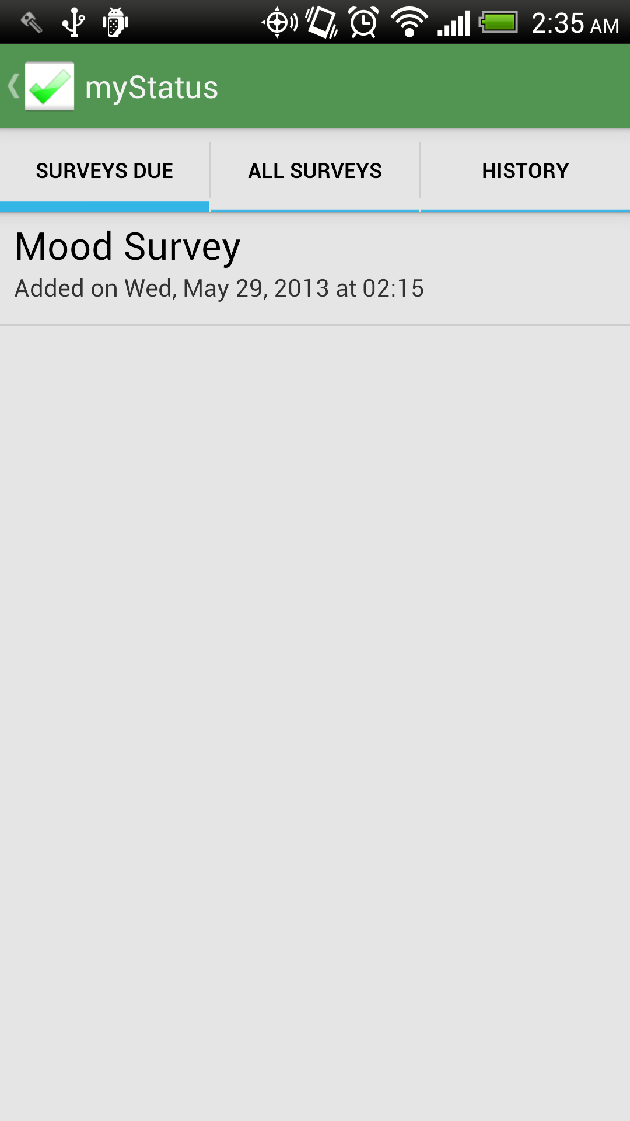
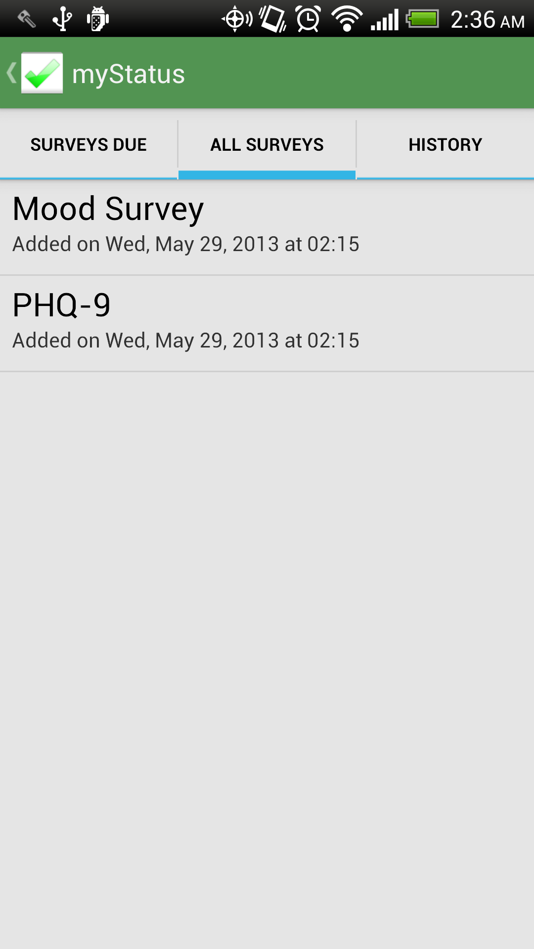
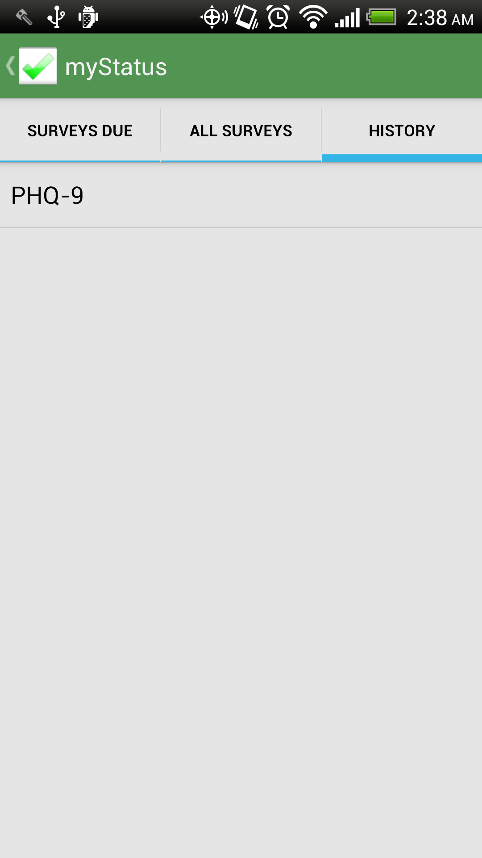
Screenshots

Slide 9
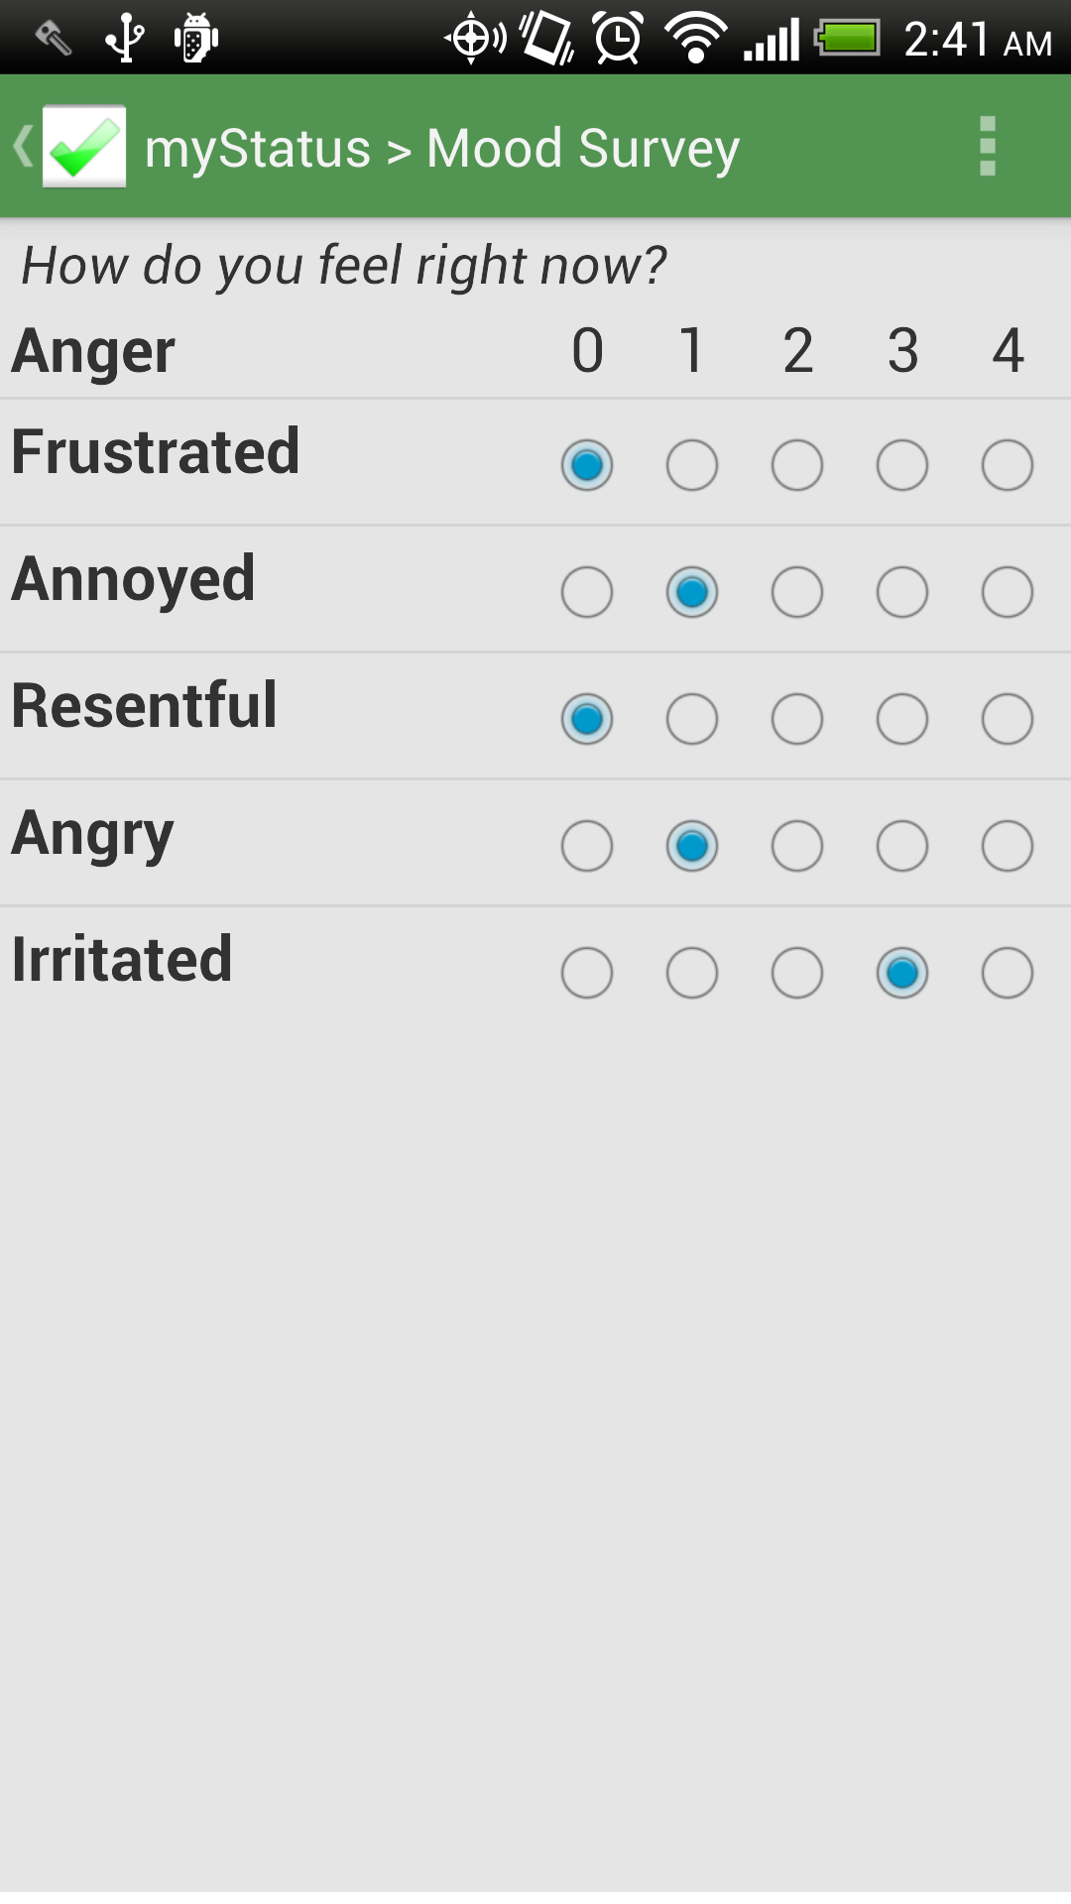
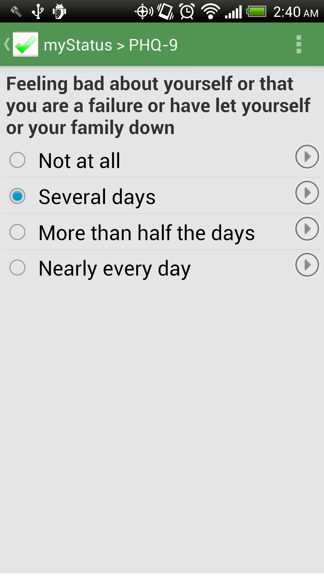
Screenshots

Slide 10
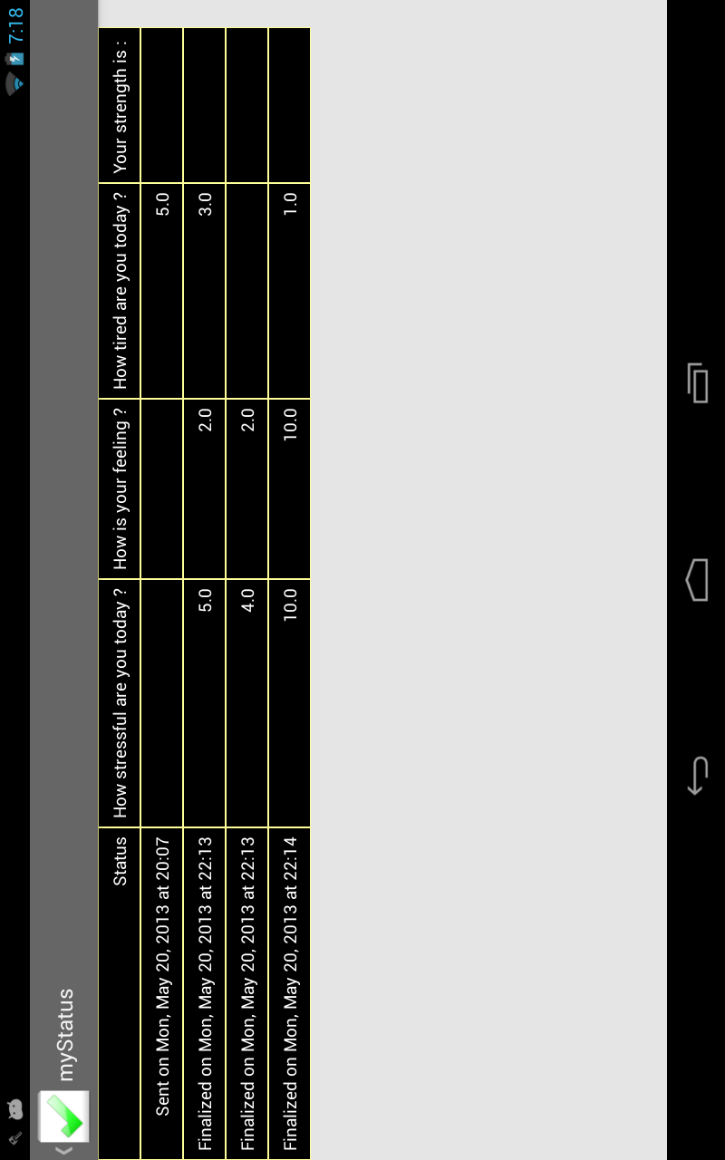
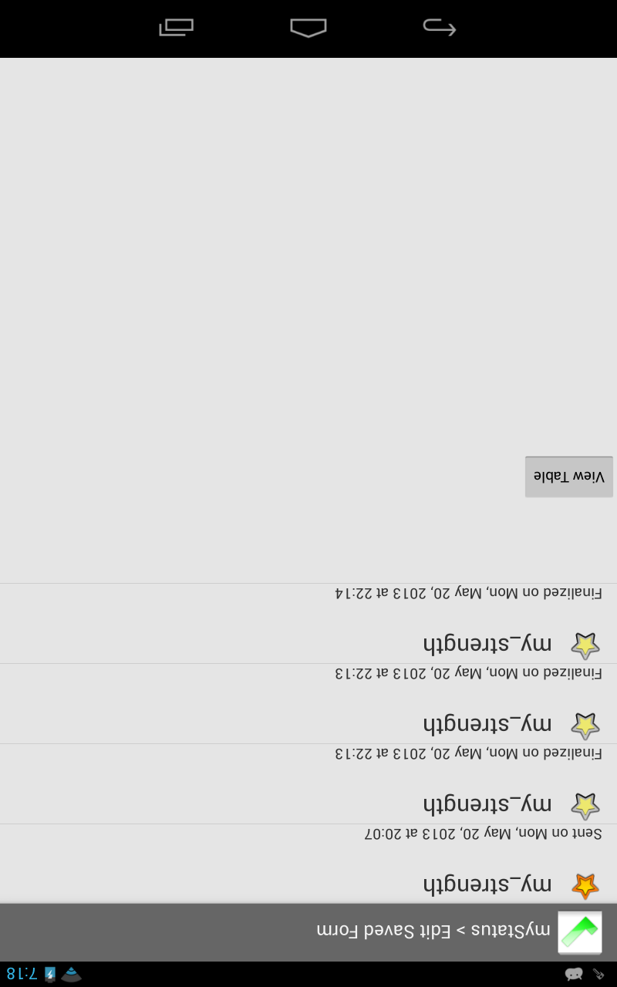
Screenshots

Slide 11
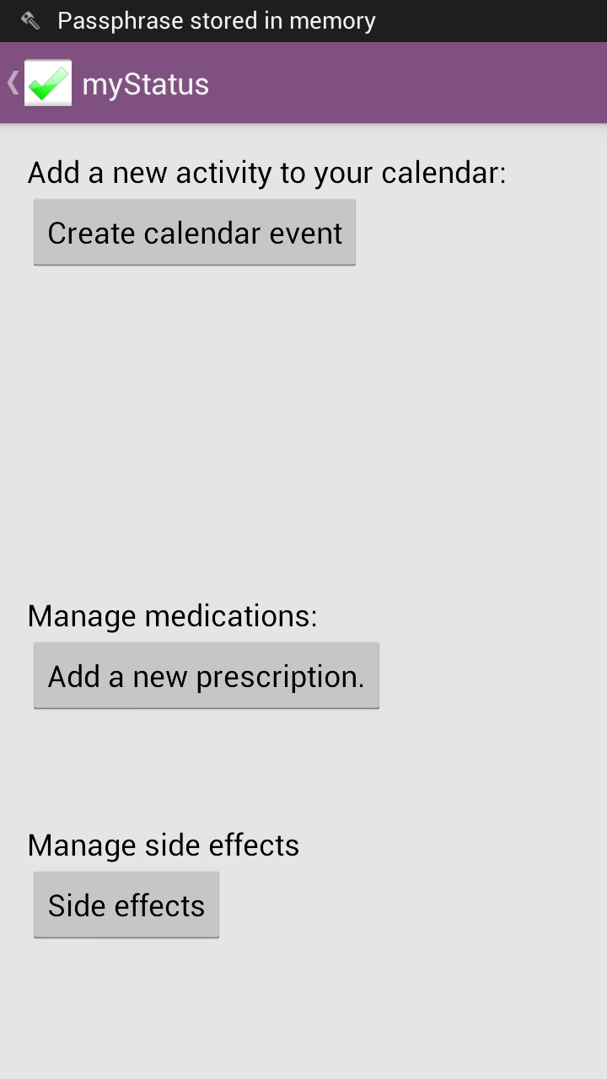
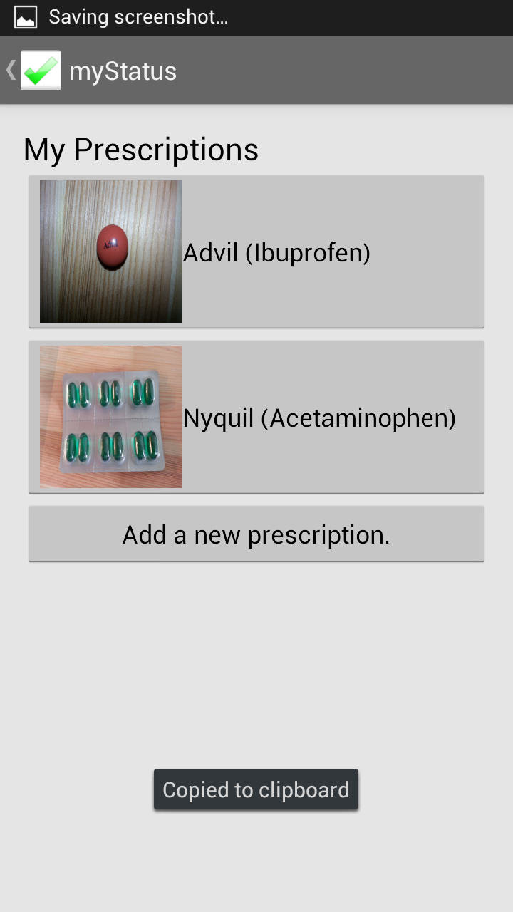
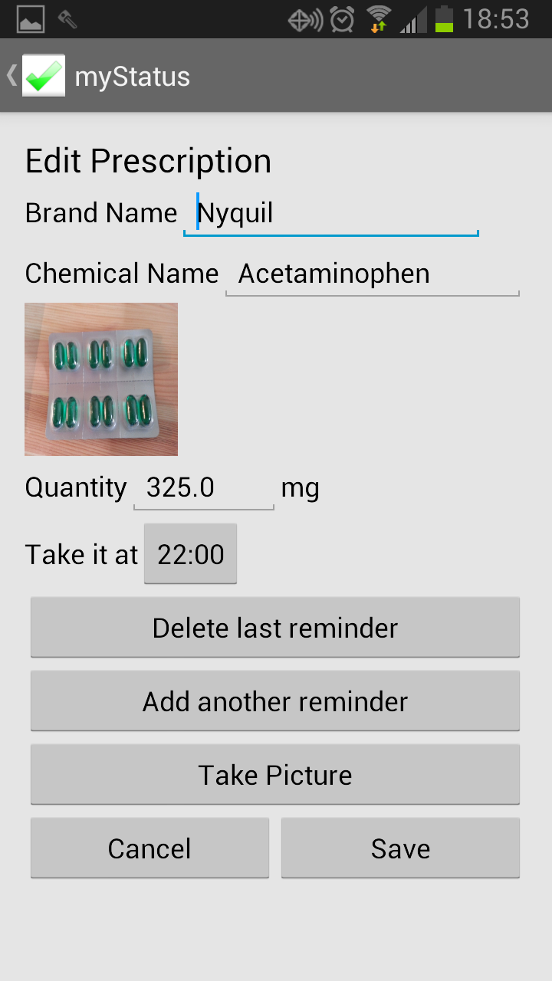
Screenshots

Slide 12
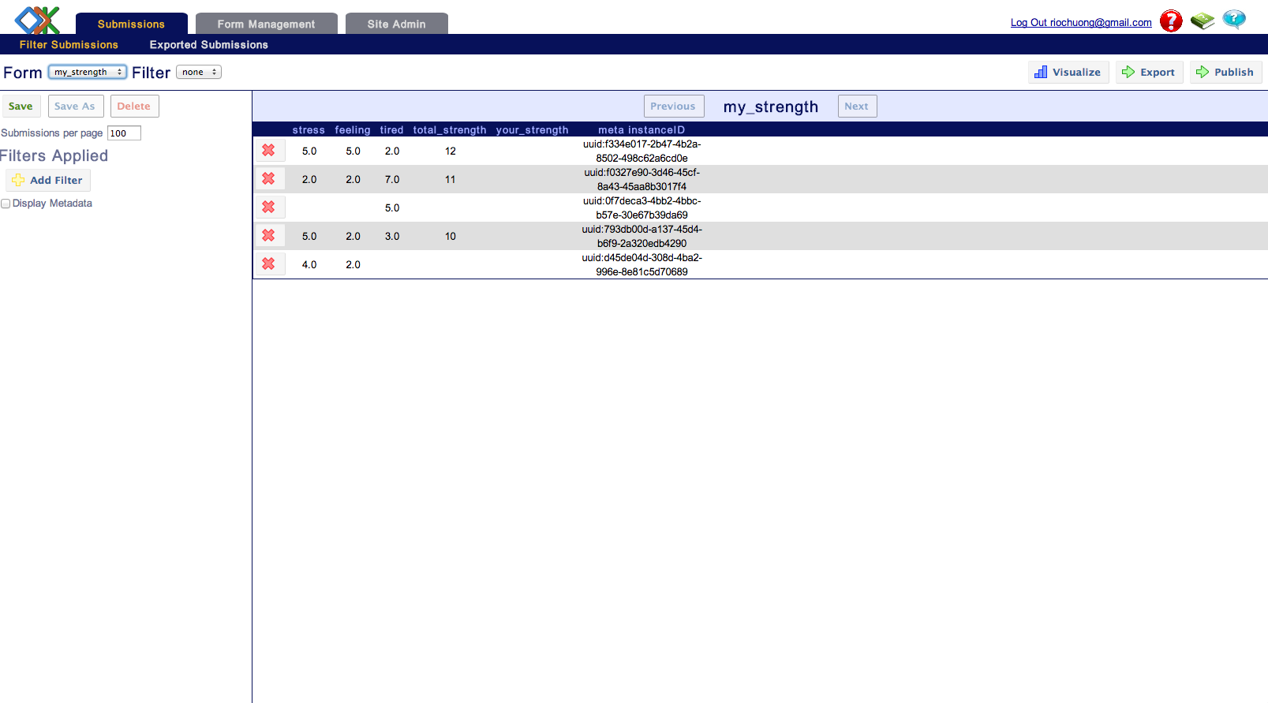
Screenshots
Notes:
export as csv

Slide 13
Challenges
Keeping compatibility with API level 7
Attempt to use Collect as a library
Modifying Collect in reusable ways
Encryption of form data
Notification timing and interface for customization
Expressing when surveys need a response
User friendly interface

Slide 14
In Progress
Allow user to snooze notifications
Encrypt or discard cached forms and instances
Encrypt prescription database
Add more predicate types (one-off surveys, delayed surveys)
Various bug fixes

Slide 15
Future work
Data visualization on History page (e.g. graphing)
Integration with RedCap (or other patient information systems)
Submitting data
Visualizing collected data
Building forms and distributing them to patients
Submitting data regarding medication reminders and success at planned activities

Slide 16
Future work
Activity planning/suggestion, troubleshooting
Survey packages; e.g. longitudinal study with distinct surveys for Week 1, 2, 4, 8
Educational pages tailored to patient demographic and subscribed surveys
Automatically downloading updated surveys
Allow clinicians to set patients' survey subscriptions
Allow patients to ask clinicians questions through the app
First-time setup: input doctor info, set notification time, etc

Slide 17
Feedback
Medication tracking originally involved asking whether or not meds were taken; too annoying, unhelpful
Original design for "does this survey need a response?" predicate syntax was overcomplicated
Original plans for notification timing customization were also overcomplicated
Usually, designs became simpler in response to feedback
Attempting to make the app as easy to use as possible

Slide 18
Questions?

